Slide 1

HTTP and REST Services
HTTP, Request Headers, RESTful Web Services
SoftUni Team
Technical Trainers
Software University
https://softuni.bg

Slide 2
Have a Question?
sli.do #js-advanced

Slide 3
Table of Contents
HTTP Overview
HTTP Developer Tools
REST and RESTful Services
Accessing the GitHub API
Popular BaaS Providers

Slide 4

HTTP Overview
Hypertext Transfer Protocol

Slide 5



HTTP Basics
HTTP (Hyper Text Transfer Protocol)
Text-based client-server protocol for the Internet
For transferring Web resources (HTML files, images, styles, etc.)
Request-response based
HTTP request
HTTP response
Web Client
Web Server

Slide 6






HTTP Request Methods
HTTP defines methods to indicate the desired action to be performed on the identified resource
Method | Description
GET | Retrieve / load a resource
POST | Create / store a resource
PUT | Update a resource
DELETE | Delete (remove) a resource
PATCH | Update resource partially
HEAD | Retrieve the resource's headers
OPTIONS | Returns the HTTP methods that the server supports for the specified URL

Slide 7
HTTP GET Request – Example
GET /users/testnakov/repos HTTP/1.1
Host: api.github.com
Accept: */*
Accept-Language: en
Accept-Encoding: gzip, deflate
User-Agent: Mozilla/5.0 (Windows NT 10.0; WOW64) AppleWebKit/537.36 (KHTML, like Gecko) Chrome/54.0.2840.71 Safari/537.36
Connection: Keep-Alive
Cache-Control: no-cache
<CRLF>
HTTP request line
HTTP headers
The request body is empty

Slide 8
HTTP POST Request – Example
POST /repos/testnakov/test-nakov-repo/issues HTTP/1.1
Host: api.github.com
Accept: */*
Accept-Language: en
Accept-Encoding: gzip, deflate
User-Agent: Mozilla/4.0 (compatible;MSIE 6.0; Windows NT 5.0)
Connection: Keep-Alive
Cache-Control: no-cache
<CRLF>
{"title":"Found a bug",
"body":"I'm having a problem with this.",
"labels":["bug","minor"]}
<CRLF>
HTTP request line
HTTP headers
The request body holds the submitted data

Slide 9
HTTP Response – Example
HTTP response status line
HTTP/1.1 200 OK
Date: Fri, 11 Nov 2016 16:09:18 GMT+2
Server: Apache/2.2.14 (Linux)
Accept-Ranges: bytes
Content-Length: 84
Content-Type: text/html
<CRLF>
<html>
<head><title>Test</title></head>
<body>Test HTML page.</body>
</html>
HTTP response headers
HTTP response body

Slide 10
HTTP Response Status Codes
Status Code | Action | Description
200 | OK | Successfully retrieved resource
201 | Created | A new resource was created
204 | No Content | Request has nothing to return
301 / 302 | Moved | Moved to another location (redirect)
400 | Bad Request | Invalid request / syntax error
401 / 403 | Unauthorized | Authentication failed / Access denied
404 | Not Found | Invalid resource
409 | Conflict | Conflict was detected, e.g. duplicated email
500 / 503 | Server Error | Internal server error / Service unavailable

Slide 11
Content-Type and Disposition
The Content-Type / Content-Disposition headers specify how the HTTP request / response body should be processed
JSON-encoded data
UTF-8 encoded HTML page. Will be shown in the browser
Content-Type: application/json
Content-Type: text/html; charset=utf-8
Content-Type: text/html; charset=utf-8
Content-Type: application/pdf
Content-Disposition: attachment;
filename="Financial-Report-April-2016.pdf"
This will download a PDF file named Financial-Report-April-2016.pdf

Slide 12

HTTP Developer Tools
Browser Dev Tools, Postman

Slide 13
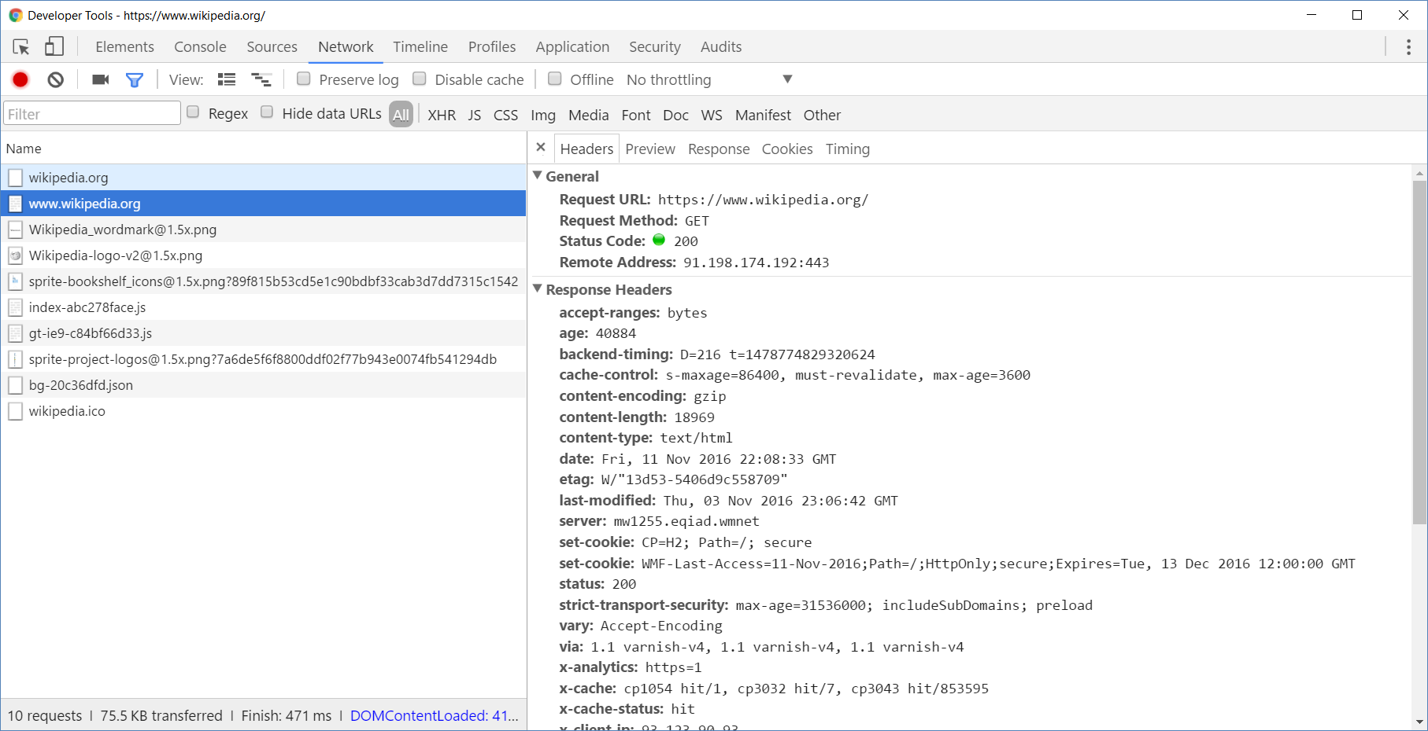
Browser Developer Tools

Slide 14
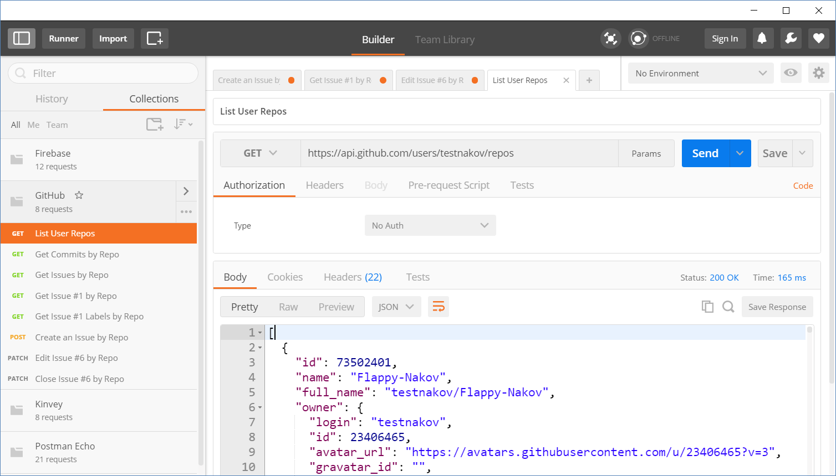
Postman
Read more about Postman REST Client

Slide 15
REST and RESTful Services
{REST}

Slide 16
REST and RESTful Services
Representational State Transfer (REST)
Architecture for client-server communication over HTTP
Resources have URI (address)
Can be created/retrieved/ modified/deleted/etc.
RESTful API/RESTful Service
Provides access to server-side resources via HTTP and REST
REST Web Service
URI
Resource
Representation 1
Representation 2
Representation 3
Representation 4
GET
PUT
POST
DELETE
Uniform Method

Slide 17

REST Architectural Constraints
REST defines 6 architectural constraints which make any web service a true RESTful API
Client-server architecture
Statelessness
Cacheable
Layered system
Code on demand (optional)
Uniform interface
Read more about REST Architectural Constraints

Slide 18
REST and RESTful Services – Example
Create a new post
Get all posts / specific post
Delete existing post
Replace / modify existing post
POST
http://some-service.org/api/posts
GET
http://some-service.org/api/posts
GET
http://some-service.org/api/posts/17
DELETE
http://some-service.org/api/posts/17
PUT/PATCH
http://some-service.org/api/posts/17

Slide 19

Accessing GitHub Through HTTP
GitHub REST API

Slide 20
GitHub API
List user's all public repositories:
Get all commits from a public repository:
Get all issues/issue #1 from a public repository
GET
https://api.github.com/users/testnakov/repos
GET
https://api.github.com/repos/testnakov/softuniada-2016/commits
GET
/repos/testnakov/test-nakov-repo/issues
GET
/repos/testnakov/test-nakov-repo/issues/1

Slide 21

Github: Labels Issue
Get the first issue from the "test-nakov-repo" repository
Send a GET request to:
https://api.github.com/repos/testnakov/test-nakov-repo/ issues/:id
Where :id is the current issue

Slide 22
GitHub API
Get all labels for certain issue from a public repository:
Create a new issue to certain repository (with authentication)
GET
https://api.github.com/repos/testnakov/test-nakov-repo/issues/1/labels
POST
https://api.github.com/repos/testnakov/test-nakov-repo/issues
Headers
Authorization: Basic base64(user:pass)
Body
{"title":"Found a bug",
"body": "I'm having a problem with this."}

Slide 23
Github: Create Issue
Create an issue when you send a "POST" request
Use your Github account credentials to submit the issue

Slide 24



Popular Providers
Back-end as a Service

Slide 25
Back-end as a Service
Web applications require a back-end to store information
User profiles, settings, content, etc.
Creating a back-end can be very time consuming
Ready to use back-end services are available (free trial):
Firebase
Backendless
Back4App
And more

Slide 26
Summary
…
…
…
HTTP is text-based request-response protocol
REST uses GET, POST, PUT, PATCH, DELETE
RESTful services address resources by URL
Provide CRUD operations over HTTP
Many BaaS providers have free trials

Slide 27










Questions?

Slide 28











SoftUni Diamond Partners

Slide 29
Trainings @ Software University (SoftUni)
Software University – High-Quality Education, Profession and Job for Software Developers
softuni.bg, about.softuni.bg
Software University Foundation
softuni.foundation
Software University @ Facebook
facebook.com/SoftwareUniversity
Notes:
29

Slide 30

License
This course (slides, examples, demos, exercises, homework, documents, videos and other assets) is copyrighted content
Unauthorized copy, reproduction or use is illegal
© SoftUni – https://softuni.org
© Software University – https://softuni.bg
Notes:
30

